Slide 1
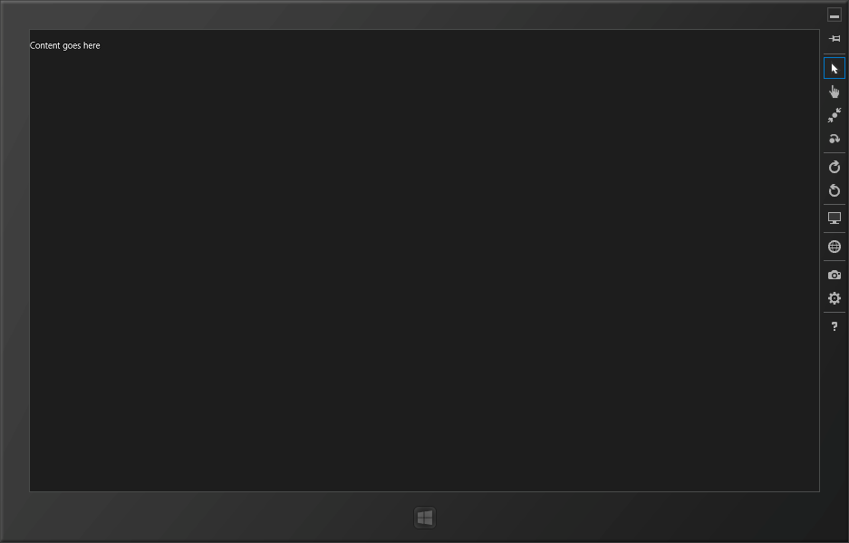
Always on top
Mouse pointer
Touch emulator
Emulate touch zooming
Emulate touch rotation
Rotate device 90 clockwise
Rotate device 90 counter-clockwise
Set resolution/scaling
Set GPS coordinates
Take a screenshot
Screenshot settings
Set network properties
Help

